Slide 1

HematoVision
Deep Learning Model for Blood Cell Subtype Classification

Slide 2
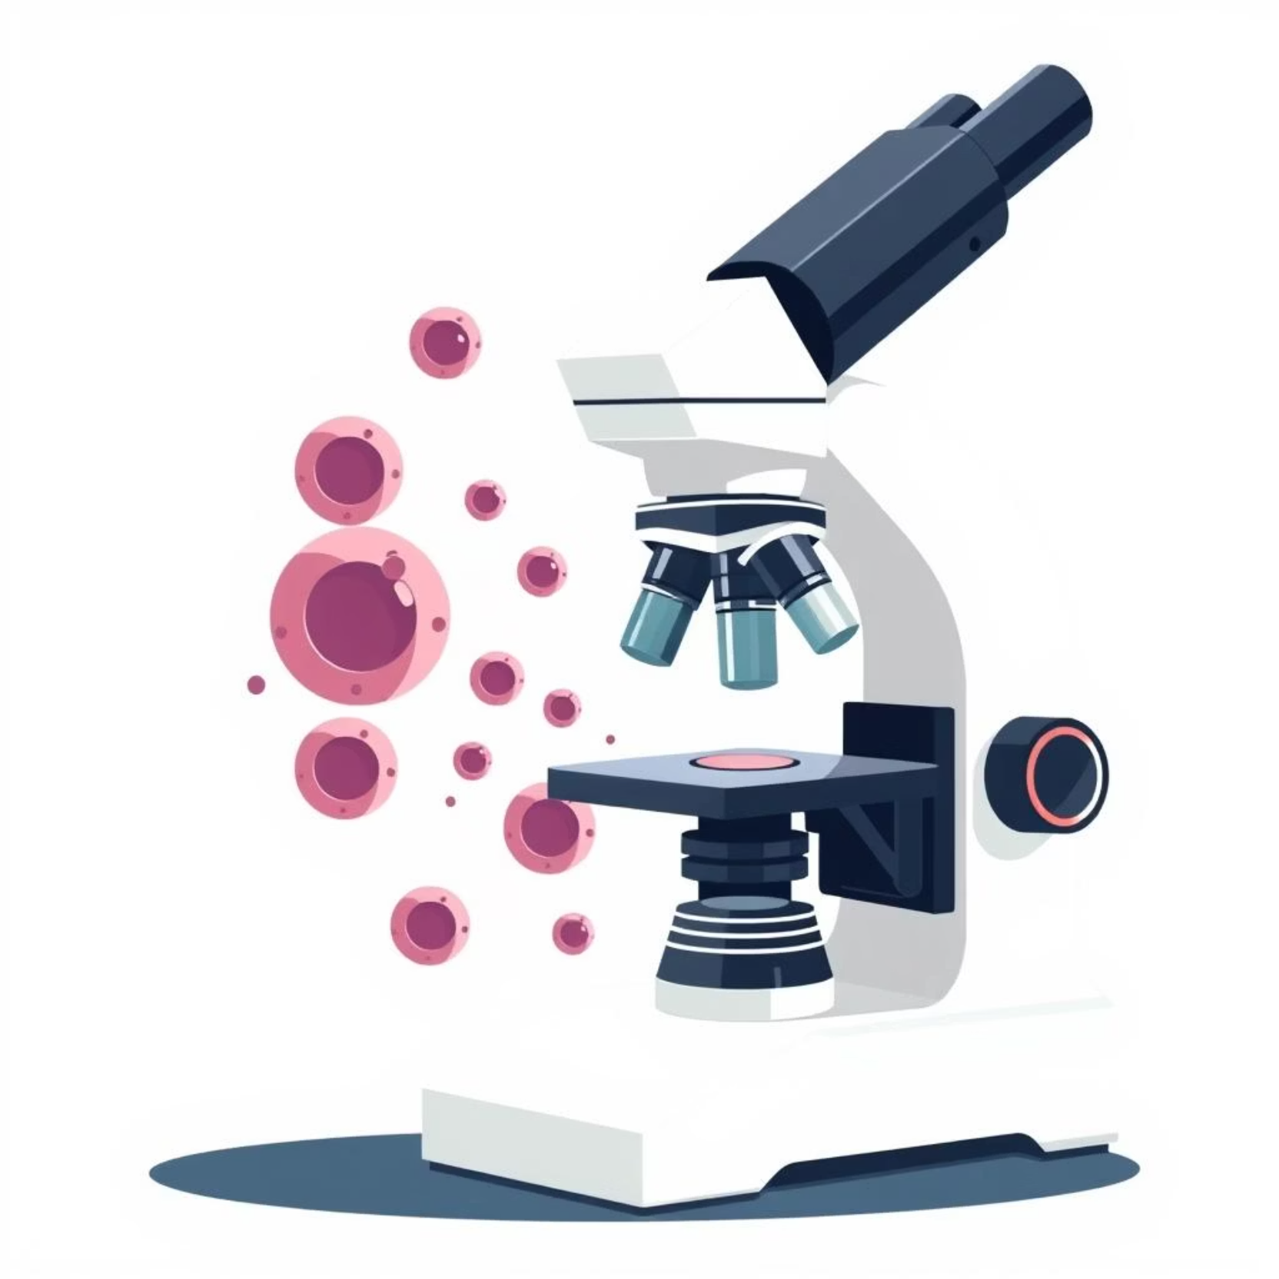
Introduction
Manual blood cell classification is time-consuming and error-prone.
Aim: Automate classification of four WBC subtypes.
Model built using EfficientNetB0 with transfer learning.

Slide 3
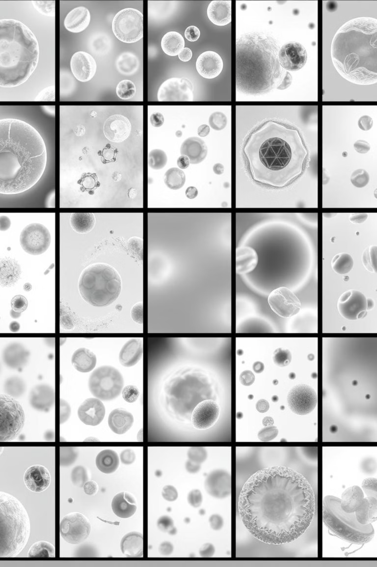
Dataset Overview
12,500 labeled images from Kaggle.
Balanced dataset: 4 classes — Eosinophil, Lymphocyte, Monocyte, Neutrophil.
Includes original and augmented images.

Slide 4

Tools & Technologies
Python, TensorFlow, Keras
NumPy, Pandas, Scikit-learn
Matplotlib, Seaborn
Grad-CAM for model interpretability

Slide 5





Data Preprocessing
Resized all images to 224x224 pixels.
Normalized image data (pixel scaling).
Augmentation: flipping, rotation, zoom.
Data split: training, validation, and testing sets.

Slide 6

Model Architecture
Base model: EfficientNetB0 (ImageNet pre-trained).
Layers: GlobalAveragePooling → Dense → Dropout → Softmax.
Optimizer: Adam | Loss: Categorical Crossentropy

Slide 7
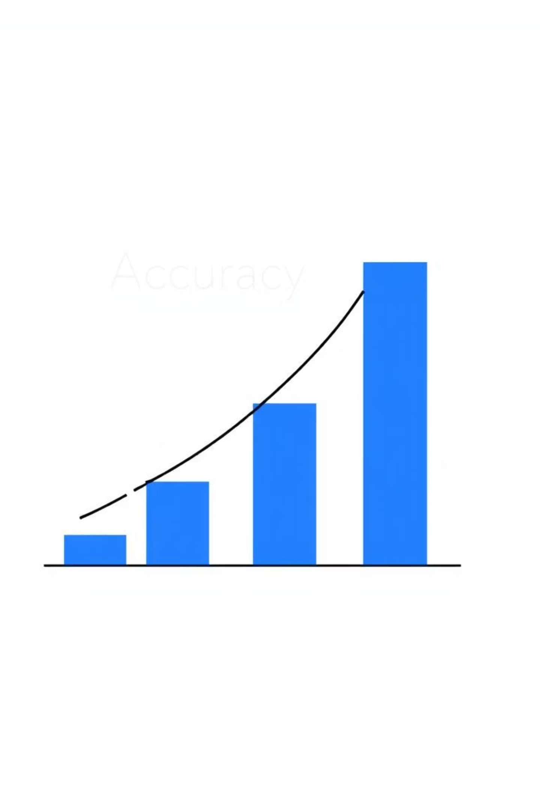
Evaluation Metrics
Metrics: Accuracy, Precision, Recall, F1-Score
Confusion matrix used for visual breakdown
Achieved ~92% validation accuracy

Slide 8
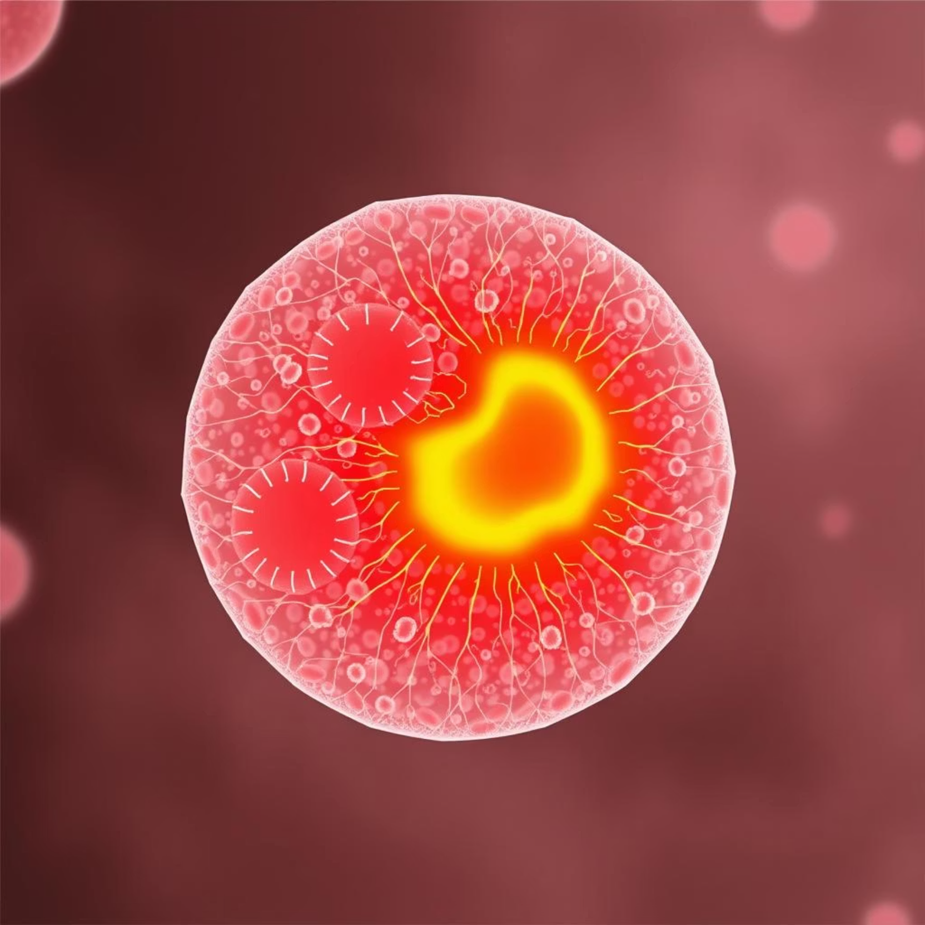
Interpretability with Grad-CAM
Used Grad-CAM to highlight decision regions.
Helps understand what parts of the image influenced predictions.
Builds trust in the model’s decisions.

Slide 9
Prediction Pipeline
Input image
Preprocess
Predict class
Returns label with probability
Visual overlay using Grad-CAM for interpretability

Slide 10
Challenges & Solutions
Challenge
Solution
Class imbalance
Solved with data augmentation
Overfitting
Used dropout and early stopping
Heavy computation
Used lightweight EfficientNetB0

